Slide 1







STACK OVERFLOW DEVELOPER SURVEY 2019
JATO DANIEL
18/2/2023

Slide 2



OUTLINE
Executive Summary
Introduction
Methodology
Results
Visualization – Charts
Dashboard
Discussion
Findings & Implications
Conclusion
Appendix

Slide 3

EXECUTIVE SUMMARY
Soft, functional and technical skills used by organizations to uncover opportunities and generate insights in the tech field is fast increasing
These skills are necessary factors for organizational competitiveness. Therefore, there is need to stay abreast of these skills in demand in order to remain relevant in the industry
This presentation reveals the current and future trends in Databases, Programming Languages Web Frames and Platforms
Overall, the aim in identifying future skill requirements and trends is to help the firm make more informed decision making for future actions

Slide 4

INTRODUCTION
This presentation has been prepared for organizations and business decision makers in the data ecosystem.
It uncovers various present and future skills requirement in the IT industry which will help tap into vast amounts of data and turn them into actionable insights.

Slide 5

METHODOLOGY
Collection of Data and data gathering
Data Exploration
Data Wrangling
Exploratory Data Analysis
Data Visualization
Dashboard Creation
Presentation

Slide 6
RESULTS

Slide 7
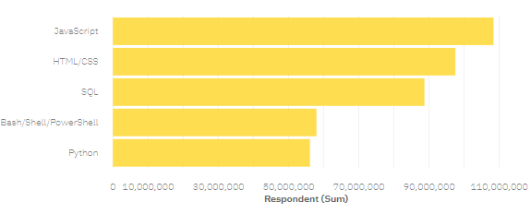
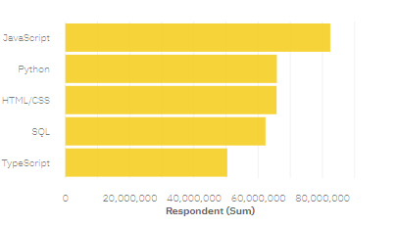
PROGRAMMING LANGUAGE TRENDS
Current Year
Next Year

Slide 8
PROGRAMMING LANGUAGE TRENDS - FINDINGS & IMPLICATIONS
FINDINGS
IMPLICATIONS
JavaScript remains the topmost language for the present and future
The demand for SQL and Bash/Shell/PowerShell seems to experience rapid decrease
The demand for python seems to experience rapid increase in the future
Employ More people with vast experience in JavaScript
Employ less people with experience in SQL & Bash/Shell/Powershell
Employ More people with vast experience in Python

Slide 9
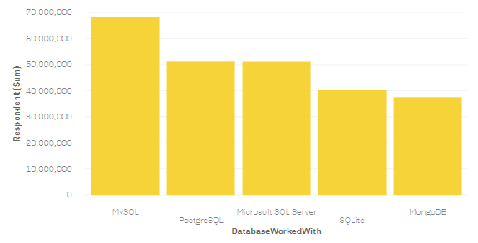
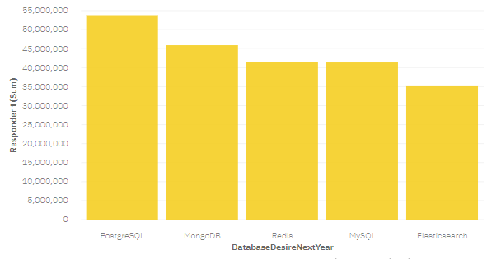
DATABASE TRENDS
Current Year
Next Year

Slide 10
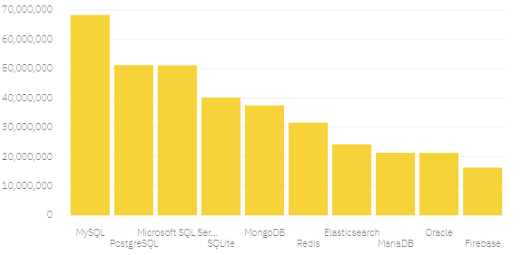
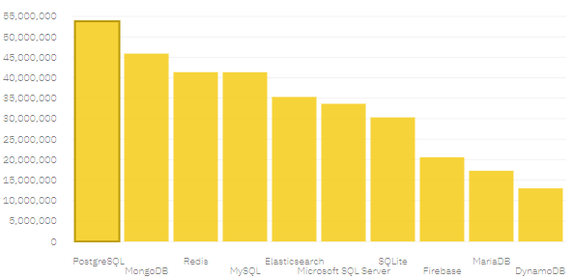
DATABASE TRENDS
Current Year
Next Year

Slide 11
DATABASE TRENDS - FINDINGS & IMPLICATIONS
FINDINGS
IMPLICATIONS
PostgreSQL is one of the top database for the present and future.
Interest in MongoDB database seems to increase for next year compared with current year.
The demand for MySQL and SQLite seems to experience rapid decrease for next year.
Employ More people with vast experience in PostgreSQL.
Employ less people with experience in MySQL & SQLite.
Employ More people with vast experience in MongoDB.

Slide 12

DASHBOARD

Slide 13
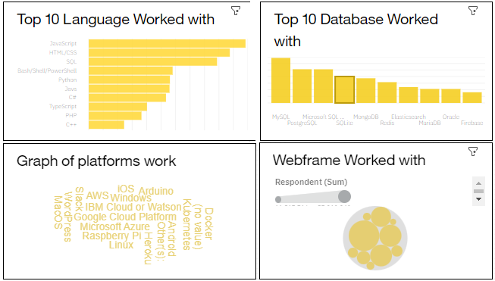
DASHBOARD TAB 1
Screenshot of dashboard tab 1 goes here

Slide 14
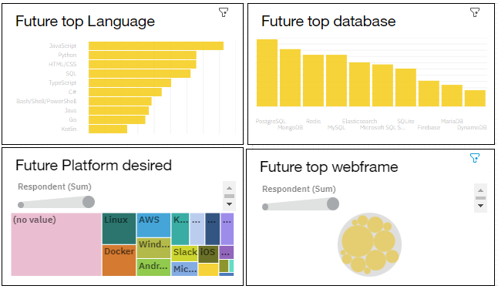
DASHBOARD TAB 2
Screenshot of dashboard tab 2 goes here

Slide 15
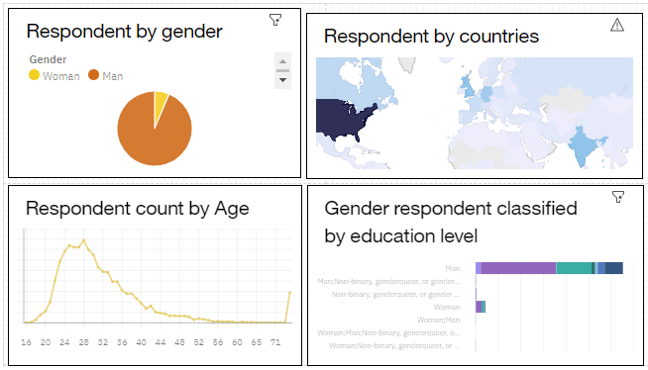
DASHBOARD TAB 3
Screenshot of dashboard tab 3 goes here

Slide 16
DISCUSSION

Slide 17
OVERALL FINDINGS & IMPLICATIONS
Findings
Implications
Programming language usch as JavaScript, Python and HTML increase in demand.
There is more interest in MongoDB and PostgreSQL databases compared to others.
WebFrames such as react.js and Angular.js have high interest curently and in the Future
Employ More people skillful in Python, JavaScript and HTML/CSS
Employ More skilled people in Linus, AWS, Mongo and PostgreSQL.
Employ More skilled peope in react.js and Angular.js webframes

Slide 18

CONCLUSION
1
There is need for plans to be set in place to recruit more people that are experience with the top in demand skills
2
In order to remain competitive in the IT industry, more spending should be focus on training of staff with the top languages, database and webframes
3
Make Future plan and set up budget towards venturing into businesses that revolves around the top webframes, platforms and database.

Slide 19

APPENDIX

Slide 20
JOB POSTINGS

Slide 21
POPULAR LANGUAGES AVG SALARY

